Slide 1
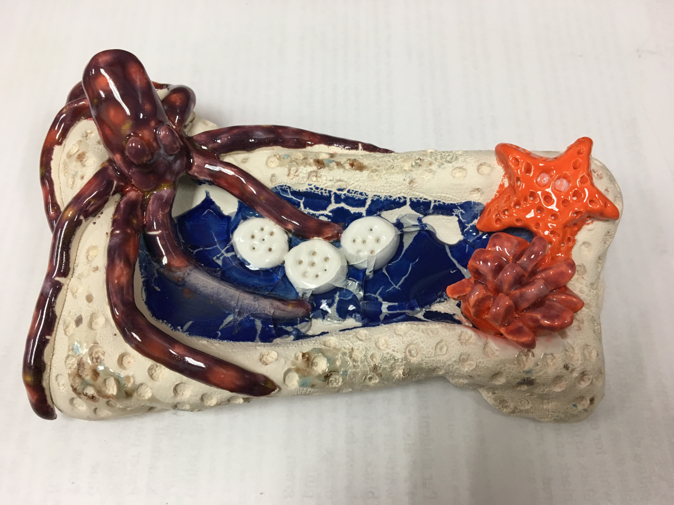
Clay with melted glass

Slide 2
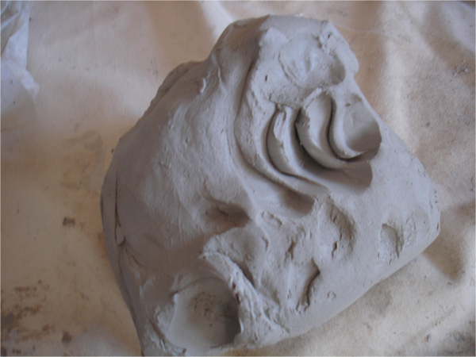
Plastic Stage
Clay is workable & moldable. It can be pushed, stretched, stamped, or impressed.

Slide 3
Greenware Stage
When clay is in the stages of drying: wet, damp, soft leather-hard, stiff leather-hard, dry, and bone dry.
Once it is dry and light gray in color, it becomes very fragile. If placed in water, it will return to a lump of soft clay.
Must be bone dry before firing in the kiln (1-2 weeks of air drying).

Slide 4
Bisqueware Stage
After clay is bisque fired in the kiln (goes up to approximately 2000 degrees and takes 24 hours)– becomes hard, durable, waterproof

Slide 5
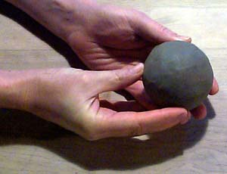
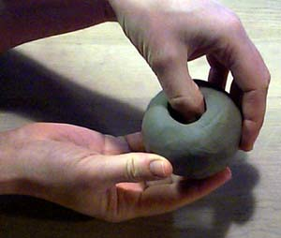
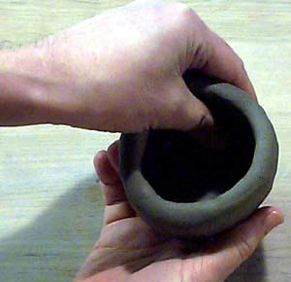
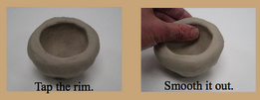
Steps for making pinch pots
Step 1) Make the clay into a round ball
Step 2) Push your thumb in the center but leave ¼ thick clay on bottom and walls
Step 3) Pinch and turn while holding in the palm of your hand
Steps 4 & 5)
Notes:
Docent note – you may want to watch the you tube video for how to make a pinch pot at
http://www.youtube.com/watch?v=5UL5fQtO6qk

Slide 6
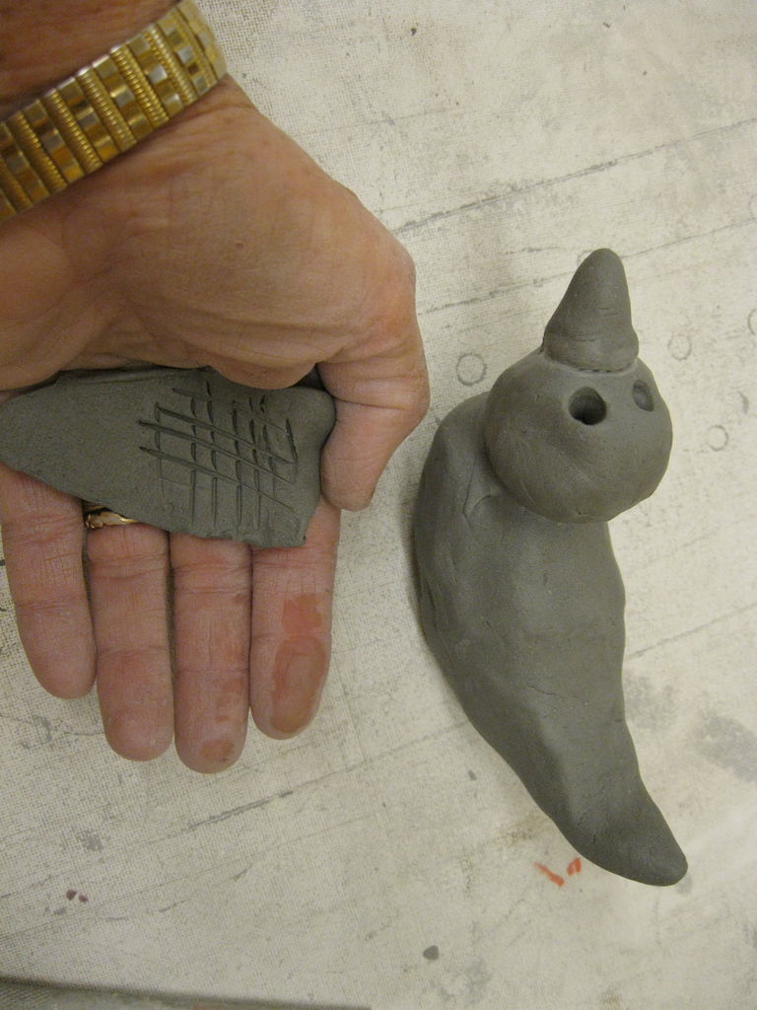
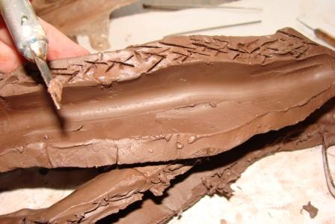
How to attach clay pieces (Score and Attach)
Make scratches in clay like small tic tac toe marks. This is called scoring.
Both pieces being attached need these scratch marks.
Put a drop of water on each piece over the scratch marks.
Push the pieces together by connecting the scratch marks like velcro.

Slide 7
Tips to remember with this project:
*Your clay shape MUST have walls at least one inch high so that when the glass beads melt they will stay in the clay and not leak out. Don’t make the walls or floor of project too thin or they will not be stable.
*Score and attach any clay pieces together (make lots of # signs on both pieces that you are joining)
* Use a few drops of water to smooth any cracks in clay.
*This glass will have a “cracked” look to it after firing in the kiln.
*You can paint the inside of the clay container with any color glaze and add clear glass.

Slide 8
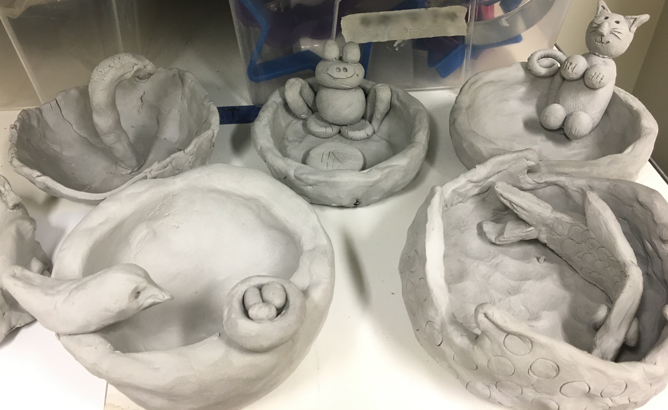
Examples of ideas for this project
Notes:
Getting started:
Students receive one canvas cloth on the desk, one slab of clay, dull pencil for writing name, cutting knife, texturizing tools (tongue depressors, screws, pinecones, marker caps, etc.), tagboard template of project, tray for project drying, bowl with few drops of water for fingertip smoothing)

Slide 9
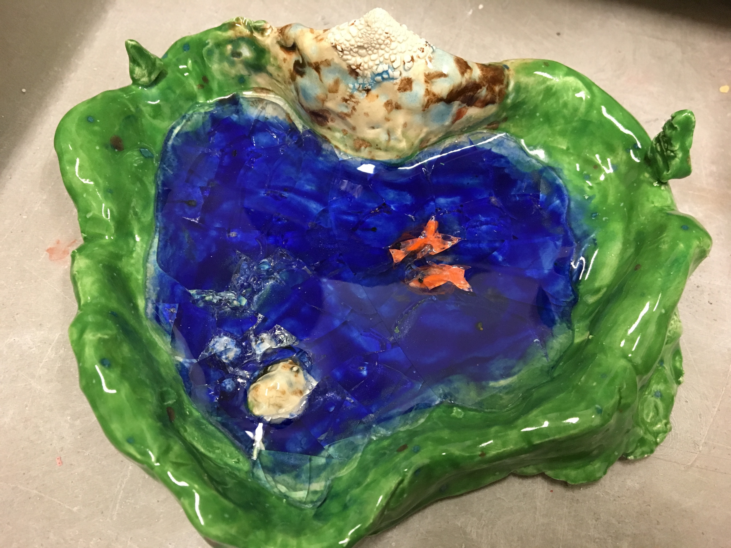

Slide 10
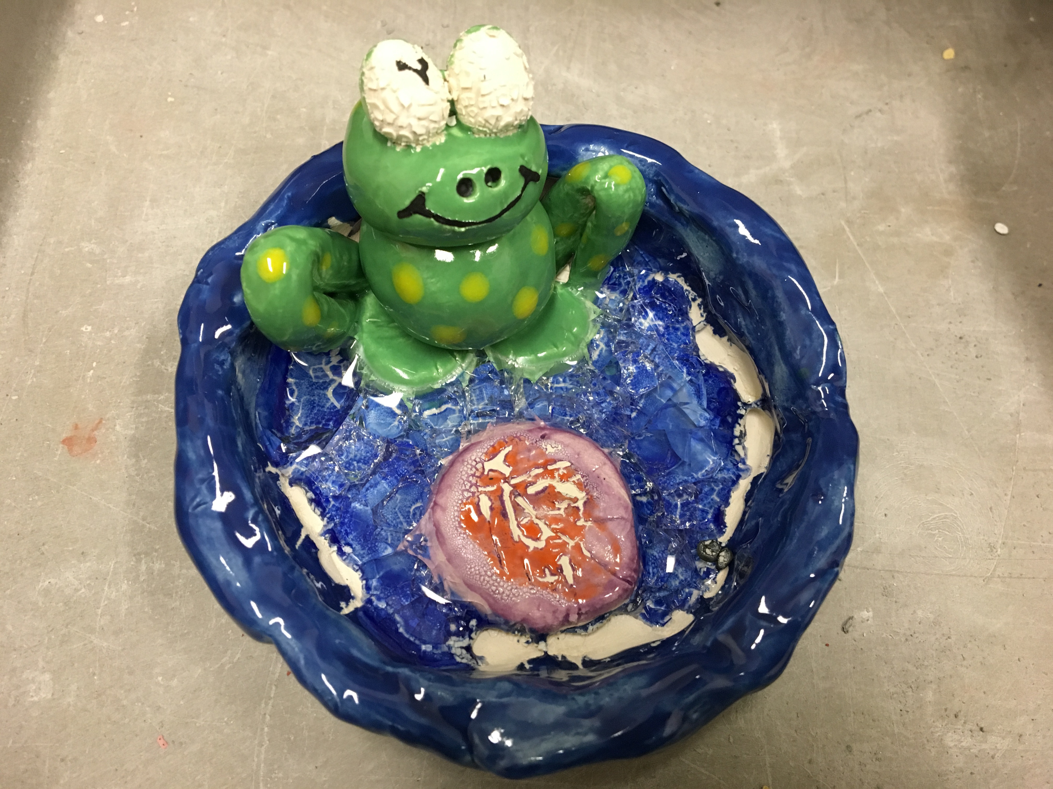

Slide 11
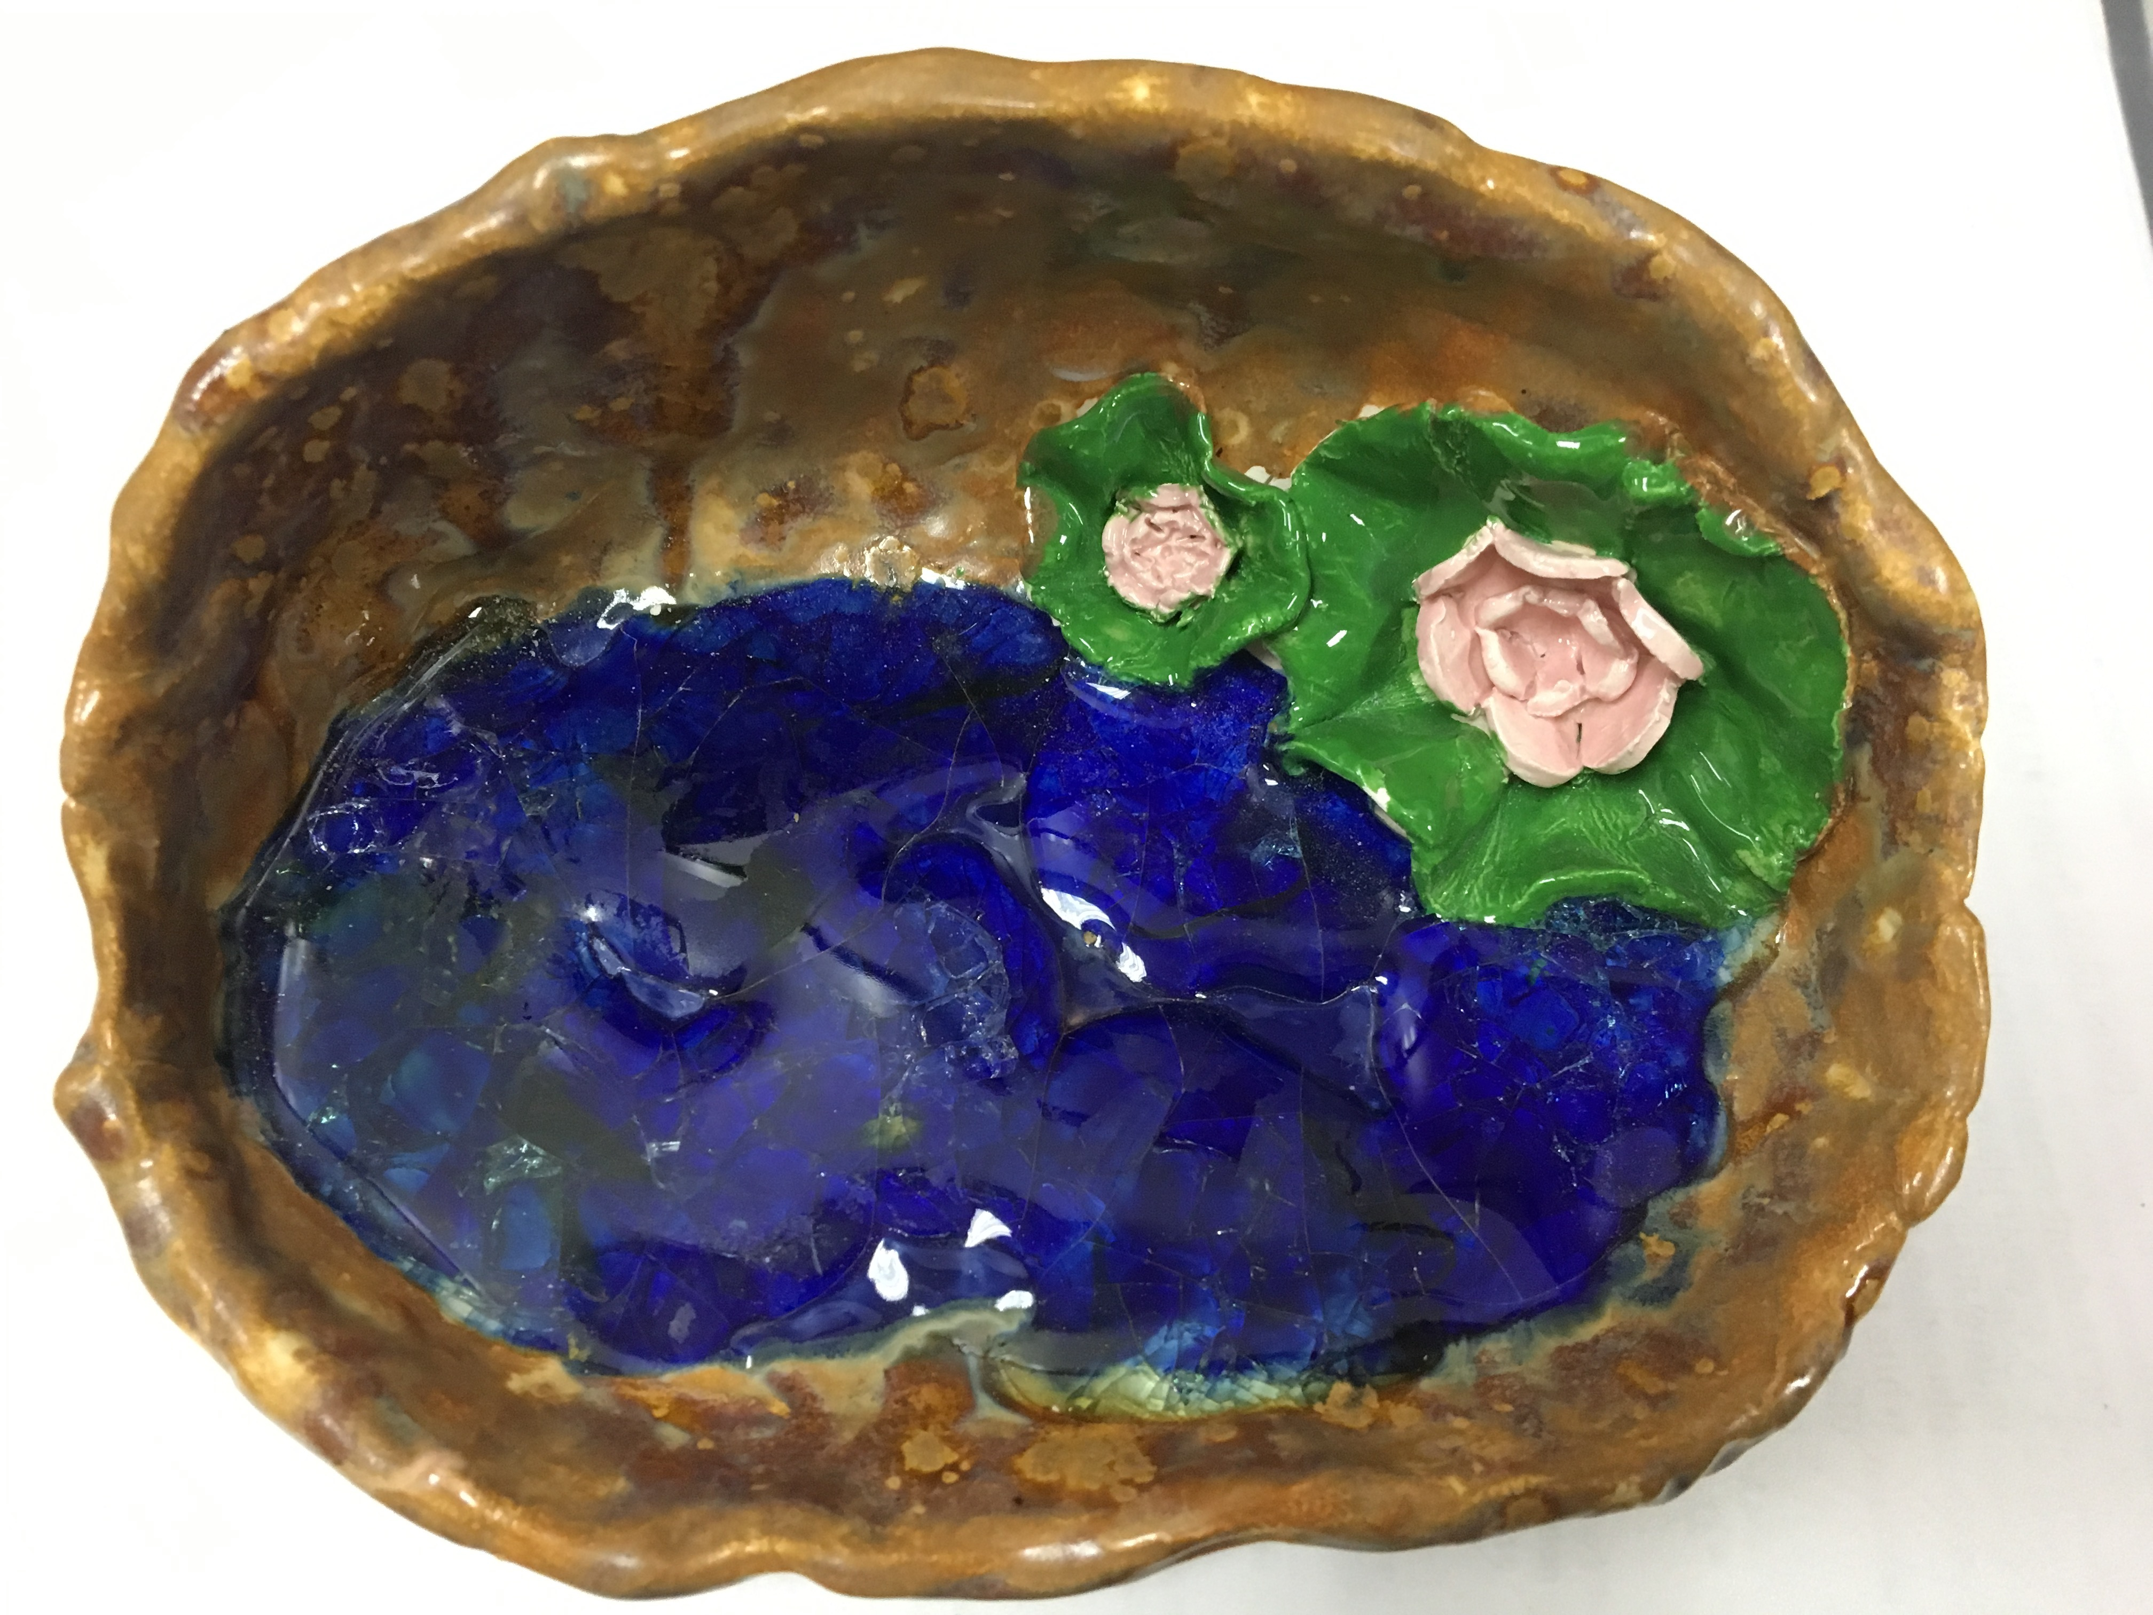

Slide 13
